Slide 1
pH scale
3.1.5

Slide 2
Syllabus Objectives
3.1.5.a understand that water is a weak electrolyte and the self-ionisation of water is represented by Kw = [H+][OH–]; Kw can be used to calculate the concentration of hydrogen ions from the concentration of hydroxide ions in a solution
3.1.5.b understand that the pH scale is a logarithmic scale and the pH of a solution can be calculated from the concentration of hydrogen ions using the relationship
pH = –log₁₀ [H⁺]
3.1.5.c use appropriate mathematical representation to solve problems for hydrogen ion concentration [H⁺(aq)], pH, hydroxide ion concentrations [OH–(aq)] and pOH.
FORMULAS
Kw = [H+][OH–].
pH = –log₁₀[H+]
pOH = –log₁₀[OH–]
pH + pOH = 14

Slide 3
REVIEW
What is a Brønsted–Lowry acid?
A proton (H⁺) donor
HCl (aq) → H⁺ (aq) + Cl⁻(aq)

Slide 4
REVIEW
What is a Brønsted–Lowry base?
A proton (H⁺) acceptor
NH₃ (aq) + H⁺ (aq) → NH₄⁺ (aq)

Slide 5
REVIEW
Identify the Brønsted–Lowry acid and base.
CH₃COOH _{(l)} +H₂O _{(l)} ⇌ H₃O⁺_{(aq)} + CH₃COO⁻ _{(aq)}
H₂SO₄ _{(l)} + H₂O _{(l)} → H₃O⁺_{(aq)} + HSO₄⁻_{(aq)}
NH_{3 (l)} + H₂O_{(l)} ⇌ NH₄⁺_{(aq)} + OH⁻_{(aq)}
Acid
Base
Acid
Base
Base
Acid

Slide 6
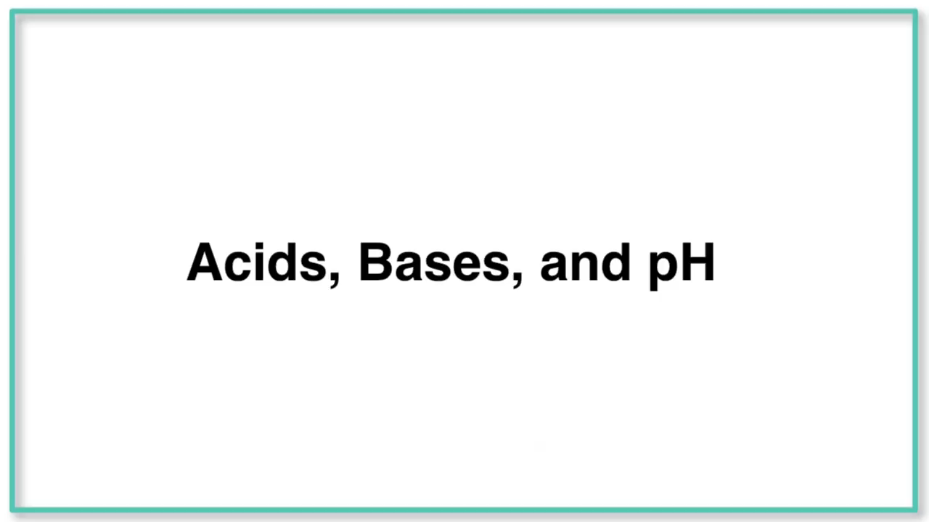
Water is self ionising (to a very small extent)
H₂O (l) + H₂O (l) ⇌ H₃O⁺ (aq) + OH⁻ (aq)

Slide 7
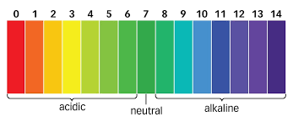
understand that water is a weak electrolyte and the self-ionisation of water is represented by Kw = [H+][OH–]; Kw can be used to calculate the concentration of hydrogen ions from the concentration of hydroxide ions in a solution
pH scale:
The pH scale can be used to indicate whether a solution is:
acidic pH < 7 (< less than)
Neutral pH = 7
Basic pH > 7 (> greater than)

Slide 8
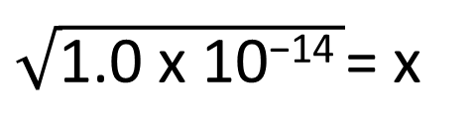
3.1.5 a understand that water is a weak electrolyte and the self-ionisation of water is represented by Kw = [H+][OH–]; Kw can be used to calculate the concentration of hydrogen ions from the concentration of hydroxide ions in a solution
At 25ºC the Kc of water is 1.0 x 10⁻¹⁴
Determine the concentration of H₃O+ and OH⁻ at equilibrium for the ionisation of water.
H₂O (l) + H₂O (l) ⇌ H₃O⁺ (aq) + OH⁻ (aq)
1. State the equilibrium constant equation
3. Substitute and solve.
Kc = [H₃O⁺] [OH⁻]
Kc = [H₃O⁺] [OH⁻]
1.0 x 10⁻¹⁴ = [x] [x]
2. Determine what variable we will use for [H₃O⁺]
1.0 x 10⁻¹⁴ = x²
Let [H₃O⁺] be x
$\sqrt{\text{1.0 }\text{x}\text{ 10−14} }$= x
1.0 x 10⁻⁷= x & x = 1.0 x 10⁻⁷

Slide 9
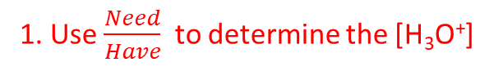
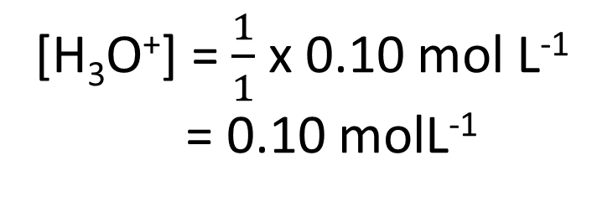
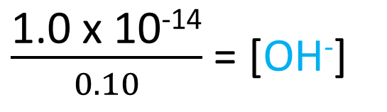
understand that water is a weak electrolyte and the self-ionisation of water is represented by Kw = [H+][OH–]; Kw can be used to calculate the concentration of hydrogen ions from the concentration of hydroxide ions in a solution
Using the value of K_{w} of water is 1.0 x 10⁻¹⁴ at 25ºC
Calculate the concentration of H₃O+ and OH⁻ in 0.10mol L⁻¹ HCl.
HCl (aq) + H₂O (l) → H₃O⁺ (aq) + Cl⁻ (aq)
1. Use $\frac{Need}{Have}$ to determine the [H₃O⁺]
2. Use Kw = [H₃O⁺] [ OH⁻] to determine [OH⁻]
Kw = [H₃O⁺] [OH⁻]
[H₃O⁺] = $\frac{1}{1}$ x 0.10 mol L⁻¹
= 0.10 molL⁻¹
1.0 x 10⁻¹⁴ = [0.10 molL⁻¹] [OH⁻]
$\frac{\text{1.0 }\text{x}\text{ 10−14}}{0.10}$ = [OH⁻]
[OH⁻] = 1.0 x 10⁻¹³ mol L⁻¹

Slide 10
3.1.5.b understand that the pH scale is a logarithmic scale and the pH of a solution can be calculated from the concentration of hydrogen ions using the relationship pH = –log₁₀ [H⁺]
pH is a measure of the concentration of H⁺_{(aq)} , [H⁺] , ions in a solution. The concentration of H⁺ ions can be stated in mol L⁻¹
HCl _{(aq)} → H⁺_{(aq)} + Cl⁻_{(aq)}
1 mol L⁻¹ → 1 mol L⁻¹ + 1 mol L⁻¹
H₂SO₄ _{(aq)} → 2H⁺_{(aq)} + SO₄²⁻_{(aq)}
1 mol L⁻¹ → 2 mol L⁻¹ + 1 mol L⁻¹

Slide 11
3.1.5.b. understand that the pH scale is a logarithmic scale and the pH of a solution can be calculated from the concentration of hydrogen ions using the relationship pH = –log₁₀ [H⁺]
pH is the negative logarithm to base 10 of the hydrogen ion concentration in an aqueous solution.
pH = -log₁₀[H⁺]

Slide 12
3.1.5.b understand that the pH scale is a logarithmic scale and the pH of a solution can be calculated from the concentration of hydrogen ions using the relationship pH = –log₁₀ [H⁺]
Calculate the pH of a solution of 0.01 mol L⁻¹ hydrochloric Acid.
Write the dissociation equation for HCl to determine [H⁺]
Use the pH equation to determine the pH.
HCl (aq) → H⁺ (aq) + Cl⁻ (aq)
0.01 mol L⁻¹
0.01 mol L⁻¹
pH = - log₁₀[H⁺]
pH = - log₁₀[0.01 mol L⁻¹]
pH = 2

Slide 13
3.1.5.b understand that the pH scale is a logarithmic scale and the pH of a solution can be calculated from the concentration of hydrogen ions using the relationship pH = –log₁₀ [H⁺]
Calculate the pH of a solution of 0.01 mol L⁻¹ Sulphuric Acid.
Write the dissociation equation for H₂SO₄ to determine [H⁺]
Use the pH equation to determine the pH.
H₂SO₄ (aq) → 2H⁺ (aq) + SO₄²⁻ (aq)
0.01 mol L⁻¹
0.02 mol L⁻¹
pH = - log₁₀[H⁺]
pH = - log₁₀[0.02 mol L⁻¹]
pH = 1.7

Slide 14
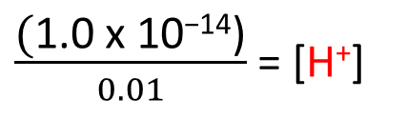
understand that the pH scale is a logarithmic scale and the pH of a solution can be calculated from the concentration of hydrogen ions using the relationship pH = –log₁₀ [H⁺]
Calculate the pH of a solution of 0.01 mol L⁻¹ NaOH
1. Write the dissociation equation for NaOH to determine [OH⁻]
2. Use the K_{w} to determine the [H⁺] 3. Calculate the pH
NaOH (aq) → Na⁺ (aq) + OH⁻ (aq)
0.01 mol L⁻¹
0.01 mol L⁻¹
K_{W} = [H⁺] [OH⁻]
pH = - log₁₀[H⁺]
1.0 x 10⁻¹⁴ = [H⁺] [0.01]
pH = - log₁₀[1.0 x10⁻¹²]
$\frac{\text{(}\text{1.0 }\text{x}\text{ 10−14)}}{0.01}$ = [H⁺]
pH = 12
1.0 x 10⁻¹² = [H⁺]

Slide 15
understand that the pH scale is a logarithmic scale and the pH of a solution can be calculated from the concentration of hydrogen ions using the relationship pH = –log₁₀ [H⁺]
Calculating [H⁺] from pH
[H⁺] = 10^{-pH}

Slide 16
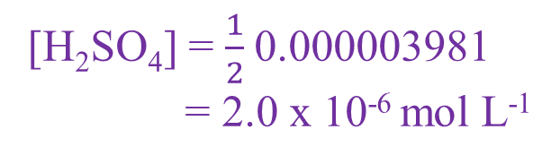
understand that the pH scale is a logarithmic scale and the pH of a solution can be calculated from the concentration of hydrogen ions using the relationship pH = –log₁₀ [H⁺]
What is the concentration of Sulphuric Acid solution when the pH is 5.4?
Determine the [H+] concentration
Use the dissociation equation to determine concentration of H₂SO₄
[H+] = 10^{-pH}
= 10^{-5.4}
= 0.000003981
= 3.98 x 10⁻⁶ mol L⁻¹
H₂SO₄ → 2 H⁺ + SO₄²⁻
1 : 2 concentration ratio
[H₂SO₄] = $\frac{1}{2}$0.000003981
= 2.0 x 10⁻⁶ mol L⁻¹

Slide 17
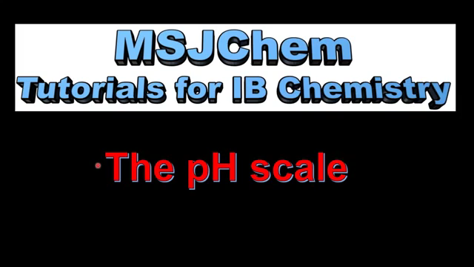

Slide 18
use appropriate mathematical representation to solve problems for hydrogen ion concentration [H⁺(aq)], pH, hydroxide ion concentrations [OH–(aq)] and pOH.
Calculate the pH of a solution when [H⁺] = 1 X 10⁻¹⁰mol L⁻¹
pH = - log ₁₀(1 X 10⁻¹⁰)
pH = - (- 10)
pH = 10
Calculate the pH of a solution when [H⁺] = 1.8 X 10⁻⁵ mol L⁻¹
pH = - log₁₀ (1.8 X 10⁻⁵)
pH = - (- 4.74)
pH = 4.74
EASY (C standard)

Slide 19
use appropriate mathematical representation to solve problems for hydrogen ion concentration [H⁺(aq)], pH, hydroxide ion concentrations [OH–(aq)] and pOH.
Calculate the concentration of H⁺ ions when a solution has a pH of 2.8.
[H⁺] = 10^{-pH}
[H⁺] = 10^{-2.8}
[H⁺] = 1.58 x 10⁻³ mol L⁻¹
EASY (C standard)

Slide 20
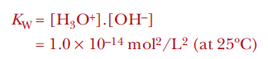
use appropriate mathematical representation to solve problems for hydrogen ion concentration [H⁺(aq)], pH, hydroxide ion concentrations [OH–(aq)] and pOH.
If the concentration of OH = 1.0 x 10⁻³ mol L⁻¹. Calculate the pH
OH NO!! It doesn’t give me the [H₃O⁺] to calculate pH = -log₁₀ [H₃O⁺].
I need to use the equilibrium constant of water (K_{w}) to solve for [H₃O⁺]
Alternative method
pH + pOH = 14
EASY (C standard)
[OH⁻] = 1.0 x 10⁻³
pOH = -log[OH-]
= - log [1.0 x 10⁻³]
= 3
pH + pOH = 14
pH = 14 – pOH
= 14 – 3
= 11
Now calculate the pH

